Slide 1
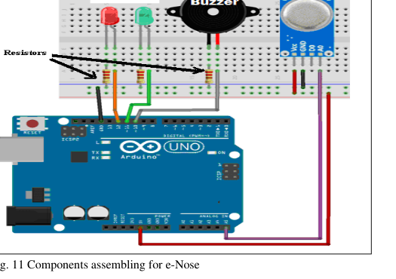
Cloud-Assisted IoT-Enabled
Smoke Monitoring System
(e-Nose) using Machine Learning Techniques
An intelligent warning prototype using Arduino, MQ-2 gas sensor, LEDs and buzzer for privacy-preserving cigarette smoke detection in public spaces.
Presented at SSIC 2019 · Springer Proceedings
Anubha Parashar · Manipal University Jaipur
Source: uploaded certificate and ICCT17 paper
01

Slide 2
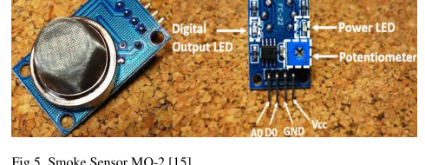
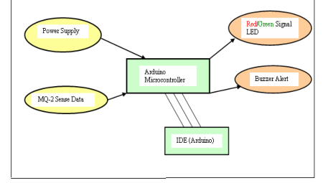
problem framing
Why this problem matters
Public no-smoking rules often fail without immediate, non-invasive enforcement feedback.
• Active and passive smoking both create serious health risks. • Camera-based detection can be costly and privacy-sensitive. • A compact sensor-based warning device can alert smokers in real time.
Sensor-based
Low cost
Real time
No camera required
Easy to assemble
Immediate warning
Source: uploaded paper, ICCT17_paper_308.pdf
02

Slide 3
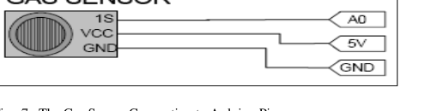
system concept
e-Nose solution overview
A simple closed-loop device: sense smoke particles, compare against a threshold, and trigger human-readable alerts.
1
Sense
2
Convert
3
Decide
4
Alert
MQ-2 samples ambient gases
Arduino reads analog voltage
Reading > threshold?
Red LED + buzzer, or green LED
Core design from the paper: sensor input + Arduino microcontroller + LED/buzzer outputs.
Source: uploaded paper, ICCT17_paper_308.pdf
03

Slide 4
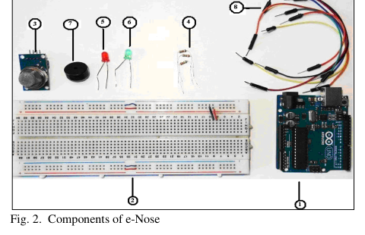
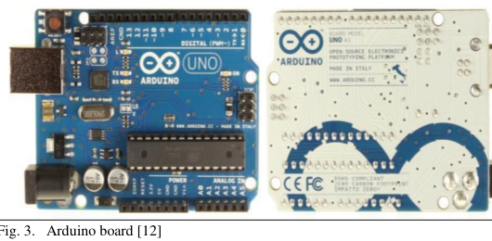
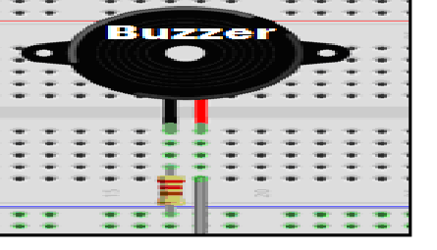
prototype build
Hardware stack and signal path
Bill of materials
• Arduino UNO board • MQ-2 smoke detection sensor • Breadboard + jumper wires • Red/Green LEDs, buzzer, resistors
Signal path
MQ-2 output voltage → Arduino analog read → threshold decision → LED/buzzer action
Source: uploaded paper, ICCT17_paper_308.pdf
04

Slide 5
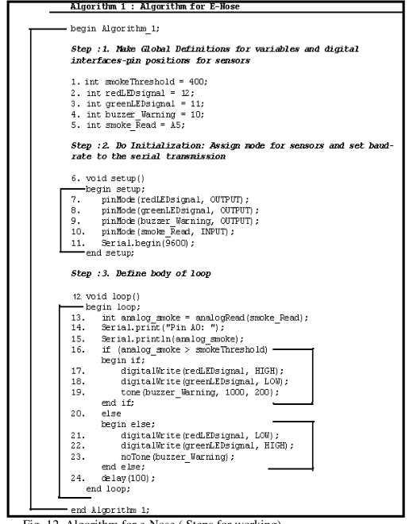
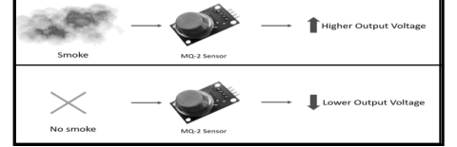
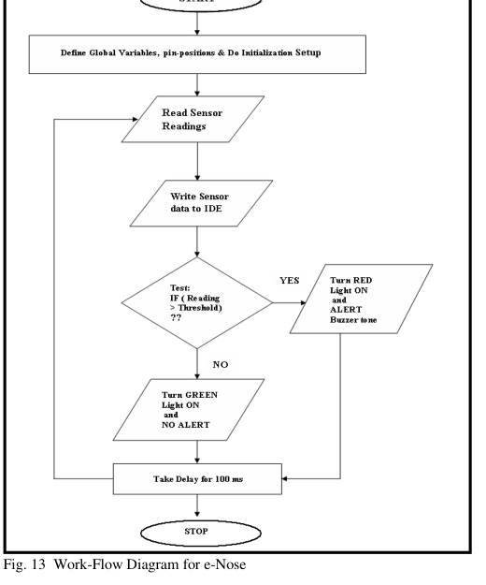
algorithm
Sensing logic: smoke thresholding
400
Configured smoke threshold
A5
Arduino analog input
100 ms
When sensor reading exceeds the threshold, the prototype turns the red LED on and plays a buzzer tone; otherwise, the green LED remains on.
Loop delay between reads
Source: uploaded paper, ICCT17_paper_308.pdf
05

Slide 6
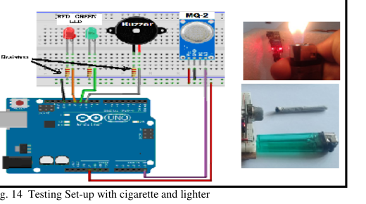
implementation
Prototype assembly and test setup
Experiment structure
• Initial environment: no smoke, green LED on. • Introduce burning cigarette smoke near sensor. • Observe alert state and recovery as smoke dissipates.
Source: uploaded paper, ICCT17_paper_308.pdf
06

Slide 7
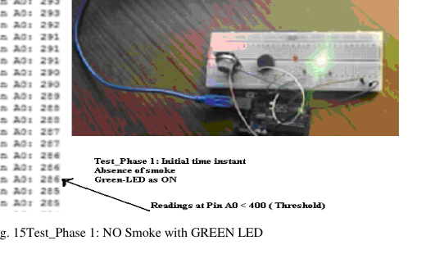
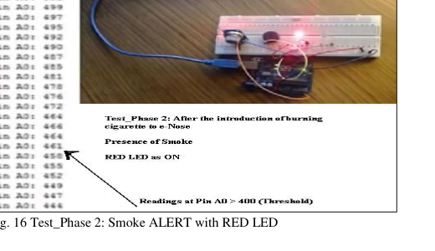
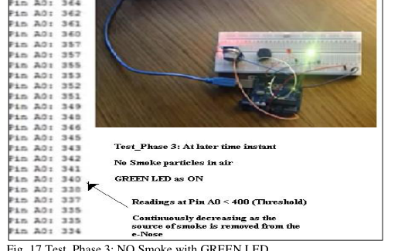
experiment results
Three-phase behavior during testing
Phase 1 · no smoke
Phase 2 · smoke alert
Phase 3 · smoke removed
Observed transition
The readings rise above the 400 threshold when smoke is introduced, then fall as smoke particles dissipate. The user-facing alert changes accordingly.
Green
Red + buzzer
Green
Normal / safe indication
Smoke warning state
Return to baseline
Source: uploaded paper, ICCT17_paper_308.pdf
07

Slide 8
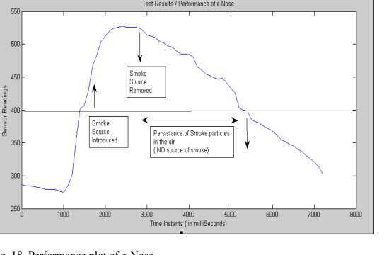
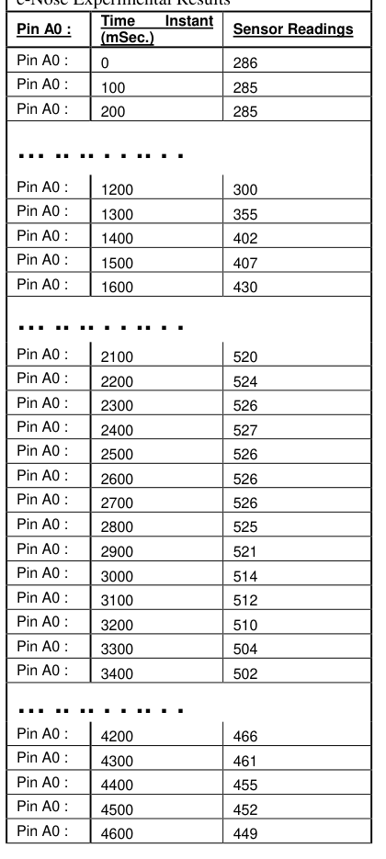
results and evidence
Experimental performance
Key interpretation
• Baseline readings stay below threshold. • Smoke source pushes readings above 400. • Peak readings reach around 520+ in the recorded samples. • Reported overall accuracy is 96.5%.
96.5%
Reported prototype accuracy
≈ 520+
Peak sample readings
Source: uploaded paper, ICCT17_paper_308.pdf
08

Slide 9
value proposition
What this work contributes
A practical IoT prototype that converts invisible smoke particles into immediate, visible and audible feedback.
• Privacy-preserving alternative to video-based smoke detection. • Low-cost components make the system deployable in public places. • Arduino-based logic is easy to replicate and tune for different thresholds. • The design can be extended with multiple sensors and machine learning.
Source: uploaded paper, ICCT17_paper_308.pdf
09

Slide 10
Conference presentation & next steps
2nd International Conference on Smart IoT Systems: Innovations in Computing (SSIC 2019)
Future enhancement pathway
• Add multiple gas/environment sensors for richer context. • Use machine learning to distinguish cigarette smoke from other gases. • Connect alerts to a cloud dashboard for monitoring and analytics. • Package the system for reliable deployment in public areas.
The project demonstrates how simple embedded sensing can become a scalable, smart public-health intervention.
Source: uploaded certificate and paper
10

